Slide 1
ISMRM German Chapter – Ph.D. Student training 2024 / Freiburg im Breisgau
Hands-on MR Physics with Pulseq
MR physics of RF pulses
Tony Stöcker, DZNE Bonn, Germany
tony.stoecker@dzne.de

Slide 2
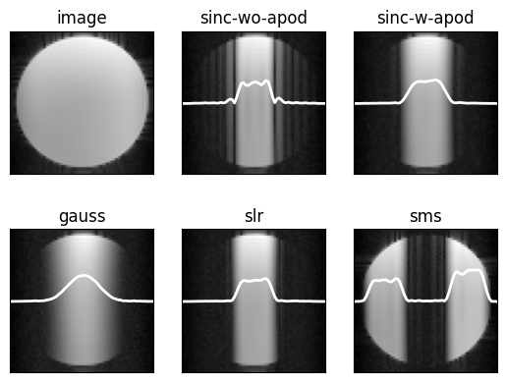
MR physics of RF Pulses
Outline
Bloch Equations with excitation
On- and off-resonant excitation
Some important RF pulses: sinc, SLR, VERSE, binomial, adiabatic
Summary
Hands-on Pulseq: Measurement of excitation slice profiles

Slide 3
Equations of classical MR physics
Bloch Equation (with relaxation)
Classical spin ½ description: dynamic of the magnetization vector
MR Signal Equation
(Complex) transverse magnetization induces voltage in the detector coils
transverse magn.
coil sensitivity
coil volume
Solutions best described in the rotating frame of reference:
BE: rotation around effective field
y
ω
SE: demodulation of the MR signal
y'
z
x
off-resonance: Δω/γ
x'
Notes:
These two equations serve more than 99% of MRI experiments!

Slide 4
The difficult part: solution of the Bloch Equation
Full Bloch Equation with matrix-vector product
General driving magnetic field of MRI: RF transmitters, gradients, and off-resonance
no analytic solution for general driving fields

Slide 5
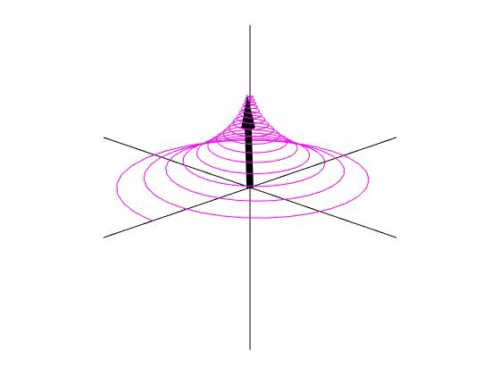
Closed-form solutions of the Bloch Equations (1)
Bloch Equation in absence of RF pulse
If the Bloch equations decouple: simple solutions
These solutions are important for the encoding step (after excitation)
z
x
y
Solution after 90°_{y} pulse:

Slide 6
Closed-form solutions of the Bloch Equations (2)
Bloch Equation with RF pulse, , and neglecting relaxation (short RF pulses)
Analytical solutions exist only in few cases:
Δω=0 ⇒ “on-resonant” rotation around ω₁:
Δω≠0, assuming small ⍺ (STA) ⇒ M_{z} ≈ 0:
Δω≠0 for some specific RF pulse shapes, e.g. ω₁=const. ⇒ rotation around effective field ω_{eff}

Slide 7
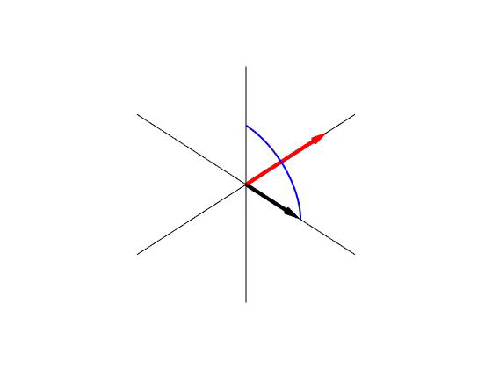
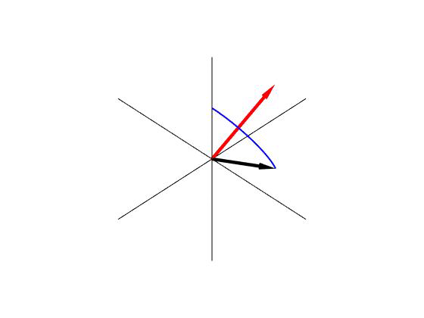
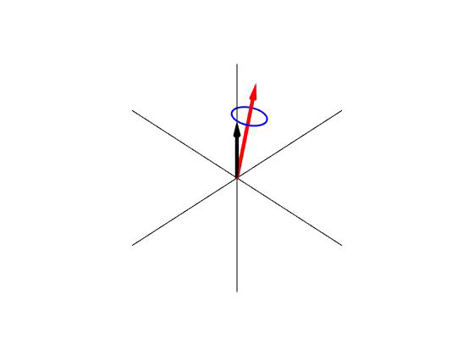
On- and off-resonance excitation
on-resonant
(Δω=0)
Medium off-resonance
(Δω > 0)
Large off-resonance
(Δω >> 0)
( Red effective field axis, Blue magnetization trajectory )

Slide 8
small tip angle approximation and slice-selection
small tip angle approximation
Off-resonance from slice selection gradient
⇒ Decoupled Bloch equation:
Solution after RF-pulse of duration τ
the RF-pulse is the Fourier Transform of the slice profile
slice rewinder

Slide 9
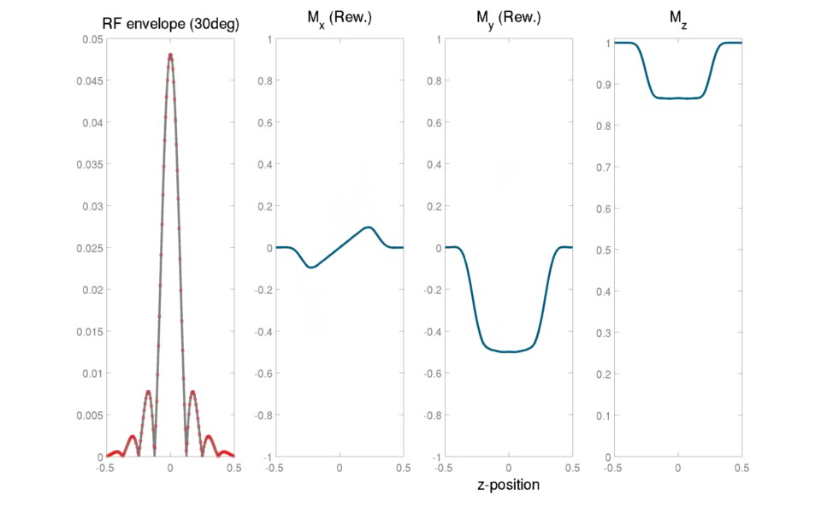
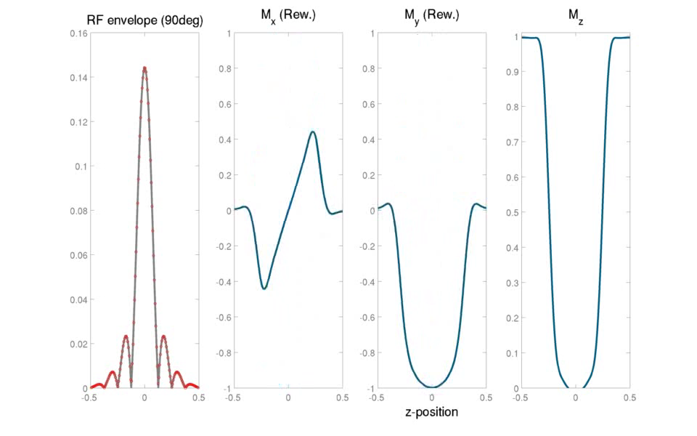
small tip angle approximation and slice-selection
30° excitation
90° excitation

Slide 10
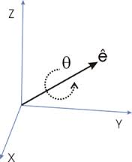
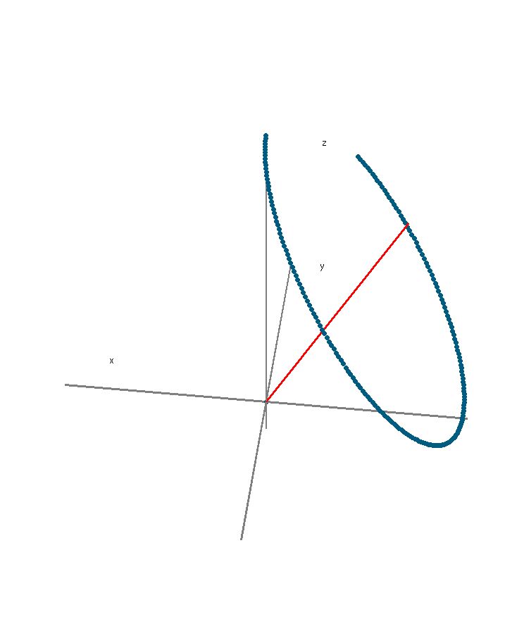
Closed-form solutions of the Bloch Equations (3)
Bloch Equation with constant RF pulse and off-resonance
Ωt
n
Solutions is a rotation around the effective Field:
nutation frequency
rotation angle after time 𝜏 is Ω𝜏 (this is not the flip angle!)
resulting flip angle¹:
resulting phase¹:
M
α
ɸ
¹ Freed DE et al. JMR 2003;162:328–335

Slide 11
numerical solutions of the Bloch equation
Two possible approaches
Use a generic ODE solver for numerical integration
Approximate the driving field to use analytical solutions:

Slide 12
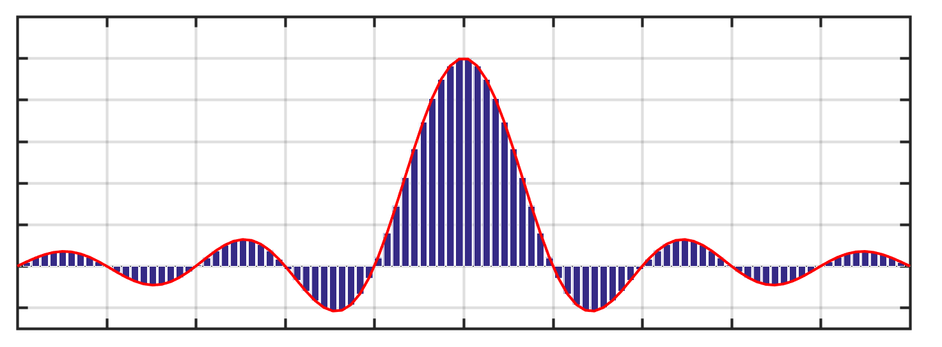
Numerical solutions of the Bloch Equation
Hard Pulse Approximation: Decompose RF pulse into short rectangular pulses
,
For each sub-pulse, the magnetization rotates around the effective field:
Total action by chained rotation matrix:
(using 2x2 complex spinor rotation basis)
Cayley-Klein parameters from rotation axis, angle (n,ɸ)
⇒ total rotation of magnetization (with )
¹ Pauly et al. 1991. “Parameter Relations for the Shinnar-Le Roux Selective Excitation Pulse Design Algorithm.” IEEE Transactions on Medical Imaging 10 (1): 53–65. https://doi.org/10.1109/42.75611.

Slide 13
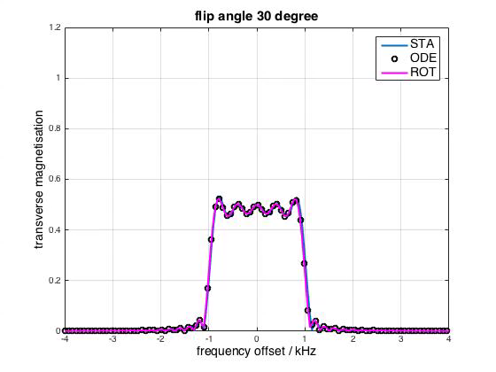
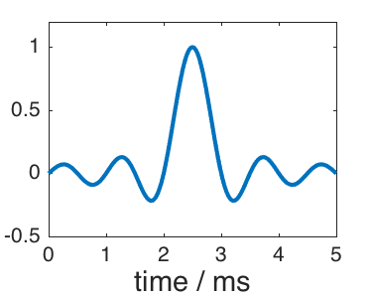
frequency response of 5 ms sinc-pulse
Comparison of three methods:
Small Tip-Angle Approximation (STA)
Numerical ODE integration (scipy odeint)
Rotation matrices (spinor)
b) and c) provide exact solutions
see notebook sinc-excitation.ipynb

Slide 14
The pulse design problem
Pulse design does not search for M,
but for ω₁ = γ B₁
Given
range of off-resonances ω_{min} < Δω < ω_{max}
pulse duration T
desired transverse magnetization {M_{x}(T, Δω ), M_{y}(T, Δω)} as a function of Δω (i.e. the slice profile where Δω=G_{z}·z)
Wanted
ω₁(t) which creates this solution at time T
(This is a strange question to ask to an ODE)

Slide 15
Shinnar-Le-Roux Pulses
Slice-Selective RF Pulses are needed up to 180deg (e.g. spin echo refocusing)
The SLR Transform is one prominent realization (many other methods exist)
Basic Idea
Solve the forward problem: “ω₁(t) given, M_{xy}(T, Δω ) wanted”
Solve the inverse problem: “M_{xy}(T, Δω ) given, ω₁(t) wanted”
Forward SLR - express net action of RF pulse in terms of a complex polynomial:
Pauly et al. 1991. IEEE TMI 10 (1): 53–65.

Slide 16
Shinnar-Le-Roux Pulses
Slice-Selective RF Pulses are needed up to 180deg (e.g. spin echo refocusing)
The SLR Transform is one prominent realization (many other methods exist)
Basic Idea
Solve the forward problem: “ω₁(t) given, M_{xy}(T, Δω ) wanted”
Solve the inverse problem: “M_{xy}(T, Δω ) given, ω₁(t) wanted”
Inverse SLR - this process is equivalent to optimal FIR filter design in signal processing!
Express M_{xy}(T, Δω ) in terms of polynomials (e.g. the Parks–McClellan algorithm)
Invert the chain of rotations by means of the spinor calculus
Obtain RF pulse that exactly fulfills the Bloch equation
Pauly et al. 1991. IEEE TMI 10 (1): 53–65.

Slide 17
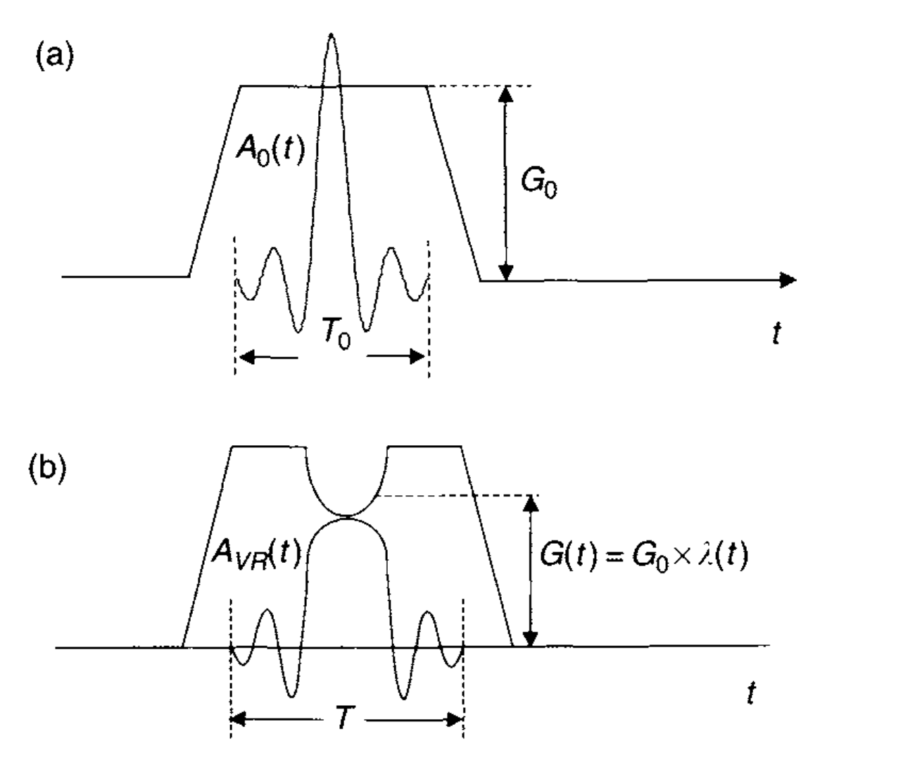
VERSE Pulses
Variable Excitation Rate Selective Excitation (VERSE)* pulses execute the RF field along with a non-constant gradient
Theory: time-dilated version of the RF Pulse, conserving area under the curve
Reduce SAR
keep flip angle
⇒
From: Bernstein et al. - Handbook of MRI pulse sequences
1. Conservation of flip angle under time stretching λ(t)<1
2. Maintain slice thickness by accordingly reduced gradient:
with instantaneous
RF bandwidth:

Slide 18
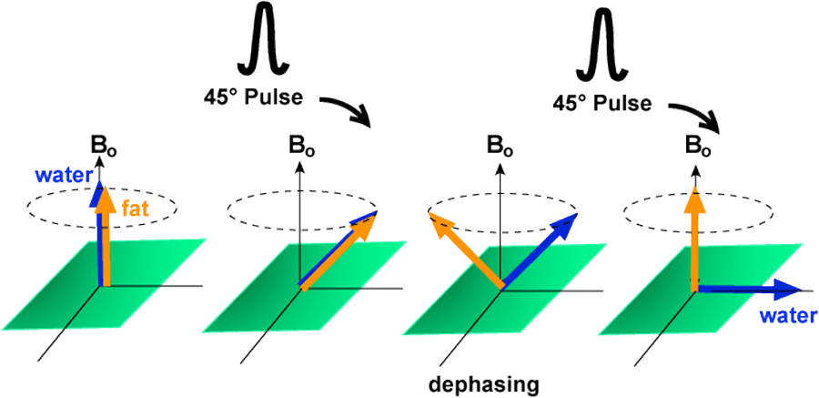
Binomial Pulses – Excitation of spectral components
Binomial pulses
have flip angles that follow the pattern of coefficients of the binomial expansion of (a+b)^{n}
1-1, 1-2-1, 1-3-3-1, etc.
Thus, a 90-pulse could be constructed as a
[45º, 45º] pair
[22.5º, 45º, 22.5º] triplet
[11.25º, 33.75º, 33.75º, 11.25º] quadruplet.
1-1 Pulse for water excitation (fat suppression)
http://mri-q.com/water-excitation.html
Time between pulses depends on off-resonance to be suppressed:
General formula (assuming instantaneous pulses):
Notes:
tau is approx. 1 ms to suppress fat at 3T (fat shift 3.5 ppm)

Slide 19
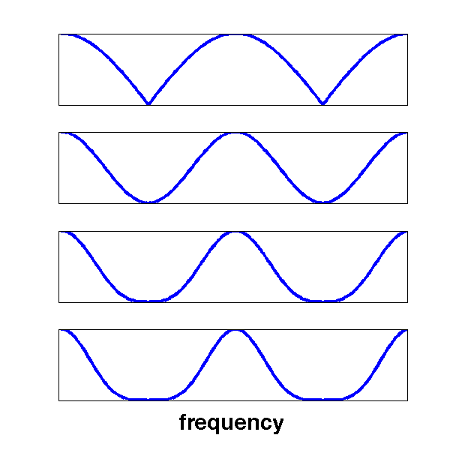
Binomial Pulses – Excitation of spectral components
The higher the order, the better is the suppression of frequencies.
STA spectral response of binomial pulses:
order n binomial pulse scheme
1 1-1
2 1-2-1
3 1-3-3-1
4 1-4-6-4-1
-Δf
Δf

Slide 20
Adiabatic Pulses
Frequency modulated (off-resonant!) pulses for spatially homogenous excitation
Effective field changes due to frequency modulation
Adiabatic condition: Magnetization follows the effective field
Flip angle independent on B1 amplitude!
adiabatic
excitation
on-resonant
excitation
Bernstein et al, Handbook of MRI pulse sequences

Slide 21
Adiabatic Pulses
Frequency modulated (off-resonant!) pulses for spatially homogenous excitation
Effective field changes due to frequency modulation
Adiabatic condition: Magnetization follows the effective field
Flip angle independent on B1 amplitude!
Adiabatic passage principle:
The magnetization vector follows the effective field, B_{eff}, if its directional change, |dΨ/dt|, is slow against the nutation frequency γ|B_{eff}|
Bernstein et al, Handbook of MRI pulse sequences

Slide 22
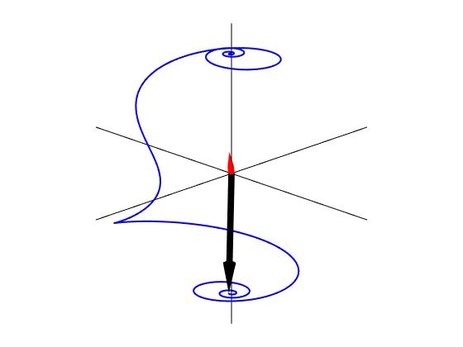
Closed-form solutions of the Bloch Equations (4)
Nonlinearity of the Bloch Equation
Analytic solution exists in case of the Hyperbolic Secant RF-pulse ¹
Bloch equation without relaxation in complex notation:
Transformation of the linear coupled system into a
single quadratic differential equation (aka Ricatti Equation):
Adiabatic Inversion
Red = effective field
Blue = magnetization trajectory
where
(no relaxation!)
¹ Singer et al, Phys. Rev. A, 1985

Slide 23
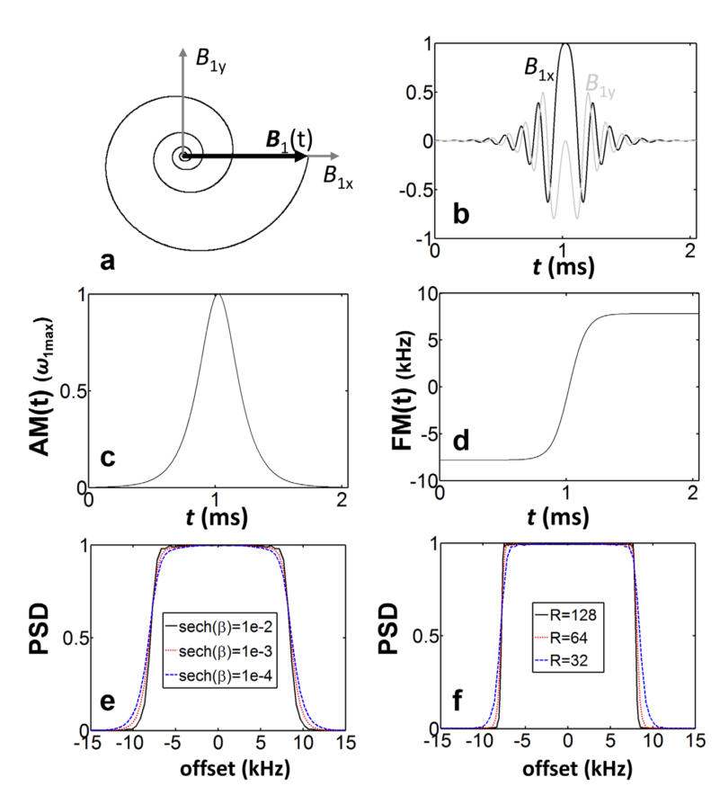
Adiabatic Pulses
The hyperbolic secant (sech) pulse
Historically the first adiabatic pulse (Singer et al 1985)
Homogenous inversion in inhomogeneous B₁-field, insensitive to off-resonance
More complicated: adiabatic pulses for excitation of arbitrary flip angles
can be achieved with so-called BIR pulses (B1-Independent-Rotation)
generally, BIR-design through numerical solutions of Bloch Equation
many BIR pulses exist with different sensitivity to off-resonance
Zhang et al, MRM 77, 2017

Slide 24
Summary
MR Physics of RF pulses
Fully described by Bloch equations
Analytic solutions only in special cases (constant RF pulse ➞ rotation around effective field)
Numerical solution with hard-pulse approximation (e.g. spinor calculus)
Pulse design for selective excitation (slice selection): SLR pulses
Other topics briefly covered: VERSE, binomial, and adiabatic pulses
Important topics not covered in this lecture
Simultaneous-multi-slice (SMS) pulses
Multidimensional selective pulses (2D or 3D)
Parallel transmit (pTx) pulses (for B1 homogenization)
Pulse design with optimal control theory (e.g. GRAPE pulses)
…

Slide 25
Measurement of the pulse profile: Hands-on Pypulseq Example
Idea of this exercise: measure the pulse profile of various RF pulses with Pulseq
Given: a basic single-slice 2D spin echo imaging sequence (URL)
Your Tasks
Change the sequence to measure the slice profile of the excitation pulse (how?)
Investigate the slice profile of the sinc-pulse with and without apodization
Change the excitation pulse and compare its slice profile with the previous results
Possible pulses available in PyPulseq: Gauss, SLR, SMS (the last two use the interface to sigpy-rf)
Implement your own pulse (?)

